Slide 1
Data transfer

Slide 2
Handling Multiple Devices
Device identification
Find starting address of ISR
Interrupt nesting
Simultaneous Interrupt Requests
Polling
Daisy chaining

Slide 3
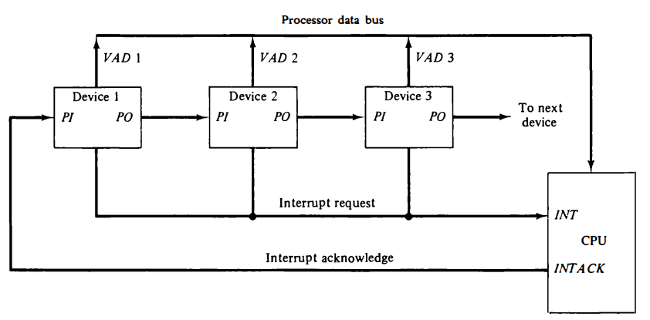
Daisy Chaining

Slide 4
Direct Memory Access (DMA)
What?
Why?
How?

